Slide 1
Introduction to DFT
Luiz Oliveira

Slide 2
Topics we can discuss in the future
Ab initio molecular dynamics (AIMD)
When DFT is not enough
When DFT is “more than enough”
Semi-empirical methods
Nuclear effects
Relativistic effects
Basis-set
Further approximations for solids

Slide 3
Topics we can discuss in the future
Ab initio molecular dynamics (AIMD) (Next week)
When DFT is not enough (HW)
When DFT is “more than enough” (HW)
Semi-empirical methods (Next Week)
Nuclear effects (Future)
Relativistic effects (Future)
Basis-set (HW)
Further approximations for solids (Future)

Slide 4
A typical DFT paper (molecules)
All of the calculations were performed using the Gaussian 09 and Orca 3.0 program packages. DFT calculations were carried out using the hybrid-type Perdew–Burke–Ernzerhof exchange correlation functional (PBE0) together with Grimme’s D3(BJ) model to add molecular mechanics damped dispersion.
DFT geometry optimizations and harmonic frequency calculations are performed with the B3LYP exchange-correlation functional in conjunction with the 6-31G(d,p) basis set.

Slide 5
Typical DFT paper (solids)
The DFT calculations have been performed using the Vienna Ab initio Simulation Package (VASP). The bulk lattice constants of IrO₂ were optimized using the (11 × 11 × 11) Monkhorst–Pack type of k-points sampling. Kohn–Sham equations are solved with the Generalized Gradient Approximation (GGA) using the Perdew–Burke–Ernzerhof (PBE) exchange–correlation functional. The IrO₂(110) surface is modeled by (2 × 1) supercells with periodic symmetric slabs of 10 layers and isolates from its periodic images for a vacuum of at least 20 Å. To describe atomic cores the Projector-Augmented-Wave (PAW) method is used. The Brillouin zone is modeled by a (2 × 2 × 1) Monkhorst–Pack k-points mesh. Atomic positions are relaxed until the sum of the absolute forces is less than 0.01 Å eV−1.

Slide 6

Alphabet soup
DFT

Slide 7

Density Functional Theory
Time-independent Schrödinger equation
The central idea in DFT is to use the electronic charge density instead
of the wave function, to calculate the ground-state total energy.

Slide 8
Density Functional Theory
Functional is a function of a function
In DFT we write our Hamiltonian (“total energy”) as a function of the electronic density
is a function of the spatial coordinates

Slide 9
Density Functional Theory
Graph from D. Loffreda

Slide 10

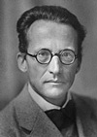
Basic Quantum Mechanics
The temporal evolution of a quantum system is given by the Schrödinger equation:
wave function
interacting potential
1926 – Erwin Schrödinger (1887 - 1961, Nobel Prize Physics, 1933)

Slide 11
Basic Quantum Mechanics
Time-dependent Schrödinger equation:
Time-independent Schrödinger equation:
Atomic units
Using Dirac’s notation:

Slide 12
Basic Quantum Mechanics
has no direct physical meaning.
Represents the probability of finding a given particle in
the position at time t.
N electrons and M nuclei
R and r are both function of the spatial and spin coordinates
It is impossible to determine, neither analytically nor numerically, the wave function of a system more complex than the hydrogen atom.

Slide 13
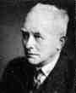
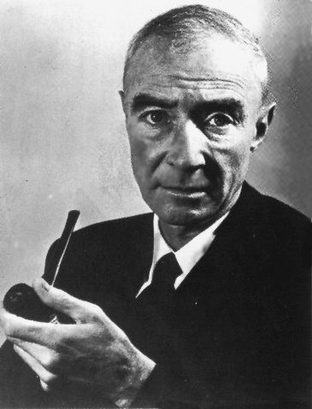
Approximations
Born-Oppenheimer approximation (aka adiabatic approx.)
Takes into consideration the fact that the mass of the nuclei is much higher than the mass of the electrons.
M. Born
J. Oppenheimer
Nobel Prize in Physics (1954)

Slide 14
Approximations
Born-Oppenheimer approximation (aka adiabatic approx.)
HΨ = E Ψ
H = T_{n} + T_{e} + V_{nn} + V_{ne} + V_{ee}
Electrons move much more rapidly than the nuclei…consider the nuclei as fixed
m_{Z} >> m_{e} (1800:1)
H_{el}Ψ = E_{el}Ψ
H_{el} = T_{e} + V_{ne} + V_{ee}
Note: In certain cases, however, quantum nuclear effects can be important.

Slide 15
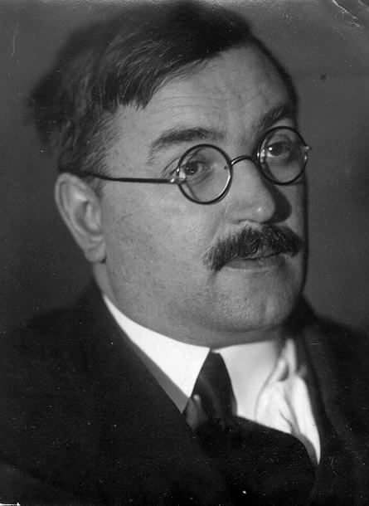
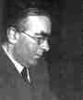
Approximations
Approximation in the wave fucntion: Hartree-Fock,
Moller-Plesset, configuration interaction.
Hartree
Fock

Slide 16
Approximations
Hartree Fock is the cornerstone of almost all conventional (wave function) approaches.
Post-Hartree Fock methods…linear combination of determinants => very accurate approaches:
Configuration Interaction (CI)
Coupled Cluster (CC)
Moller-Plesset (MP2, MP4)
Fairly limited to small system sizes
For some people these are ab initio (from the beginner) DFT is not.

Slide 17

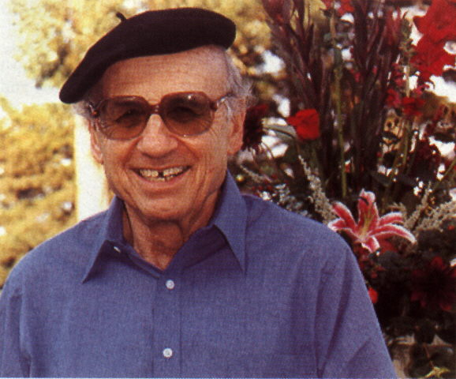
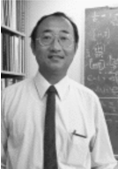
Approximation: Density functional theory.
P. Hohenberg
W. Kohn
L. J. Sham
Nobel prize in Chemistry in 1998
“for his development of the density-functional theory”

Slide 18
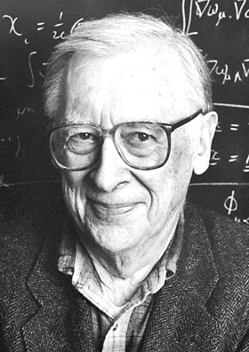
Density functional theory.
John Pople
Nobel prize in Chemistry in 1998
“for his development of computational methods in quantum chemistry"

Slide 19
Density functional theory
Alternative to Hartree-Fock
Hohenberg-Kohn theorems:
The total energy of the fundamental state of a system with many
electrons is a unique functional of the charge density.
II) The ground state energy and density can be determined by
minimizing that functional.

Slide 20
Density functional theory
The Kohn-Sham equation:
The total energy of the fundamental state of a system with many
electrons is a unique functional of the charge density.
II) The ground state energy and density can be determined by
minimizing that functional.

Slide 21
Density functional theory
Classical (Coulomb)
non-classical
unknown
Kohn et al. identified the functional but unfortunately did not deliver a means by which it could be determined

Slide 22
LCAO: Linear Combination of Atomic Orbitals
Express Molecular Orbitals (MO) as a linear combination of atomic orbitals (AO)
i
j
k
Molecular Orbital
Atomic orbitals
Coefficient determining the contribution of the AO
AOs on atom i
AOs on atom j
AOs on atom k

Slide 23
LCAO: Linear Combination of Atomic Orbitals
Use a large number of AOs.
Simplify the computation by using particular mathematical forms.
Those are more general AOs basis functions.
Molecular orbitals
Basis function
Coefficient (from SCF)
Plane Waves
Gaussians-Type Orbitals (GTO)
Slater-Type Orbitals (STO)
Basis sets:

Slide 24
In summary…
“Complete set of basis functions that is used to represent the molecular orbitals.
Gaussian functions are the most commonly used.
The basis set simply consists of the relevant exponents and coefficients of the functions”
“Broadbelt and Pfaendtner” AIChE. J., 2005, 51 (8), 2112-2121
Learn more by doing the homework.

Slide 25








Some codes used for DFT

Slide 26
Practical DFT
Exchange and correlation
DFT IN PRACTICE
IS AN APPROXIMATION: V_{XC}
DFT IS IN PRINCIPLE
EXACT
V_{XC} is an active area of research and developments are continuous.

Slide 27
Density functional theory
The Exchange-Correlation Functionals
DFT is an exact theory. But the term V_{XC} is unknown.
Different approximation to this term have been proposed.
Kohn and Sham proposed the local density approximation (LDA):
Generalized gradient approximation (GGA):

Slide 28
Jacob’s ladder
A new generation density functional towards chemical accuracy
I.Y Zhan

Slide 29
The true ladder
From Miguel M. Marques

Slide 30
Exchange-correlation functionals
Only for exchange-correlation
GGA: Generalized gradient approximation
LDA: Local (spin) density approximation
PBE: Perdew-Burke-Ernzerhof GGA functional
LYP: Lee-Yang-Par E_{C} functional
B88: Becke 88 E_{X} functional
PBE0: PBE hybrid
BLYP: GGA using B88 and LYP
B3LYP: BLYP hybrid
PW91: Perdew Wang 91
Myz (e.g. M06): Minnesota Functionals
http://www.gaussian.com/g_tech/g_ur/k_dft.htm

Slide 31
References
Original papers:
Hohenberg & Kohn, Phys. Rev. 136, B864 (1964).
Kohn & Sham, Phys. Rev. 140, A1133 (1965).
Books:
Scholl and Steckel, DFT: a practical introduction
Koch & Holthausen, A Chemist’s Guide to Density Functional Theory.
Par & Yang, Density Functional Theory of Atoms & Molecules.
Kohanoff & Gidopoulos, Density Functional Theory: Basics, New Trends and Applications, in Handbook of Molecular Physics and Quantum Chemistry.

Slide 32
Homework Part 1
Distances in Å
Bond
GAFF
UFF
More
Experiment
H-H
R(H-H)
Columns
0.741
H₃C-CH₃
R(C-C)
More
1.526
R(C-H)
Columns
1.088
H₂C-CH₂
R(C-C)
1.339
R(C-H)
1.085
HC-CH
R(C-C)
1.203
R(C-H)
1.061
Create your own tables. Include them in a Python notebook

Slide 33


Slide 34
Homework Part 2
Use gnuplot properly: http://www.gnuplotting.org/

Slide 35
Homework Part 3
Explain DFT terms for the experimentalists or even that friend doing simulation using force fields his/her entire life.
Read “Broadbelt and Pfaendtner” AIChE. J., 2005, 51 (8), 2112-2121
Google gave me this: “DFT: A method of obtaining an approximate solution to the Schrödinger equation of a many-body system.”

